Slide 1
Ohm's Law for Closed Circuits

Slide 2
Why does a battery heat up? What is the expression for the heat generated?

Slide 3
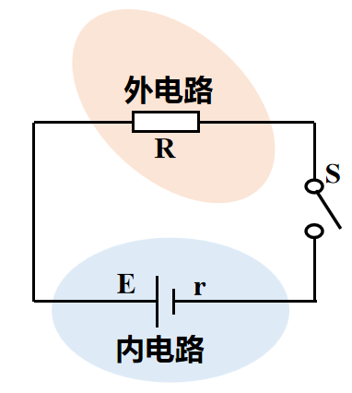
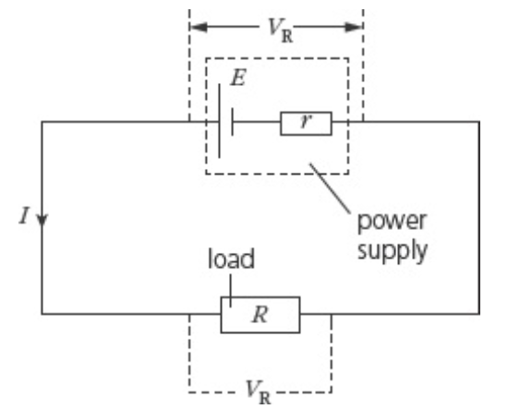
Closed Circuits

Slide 4
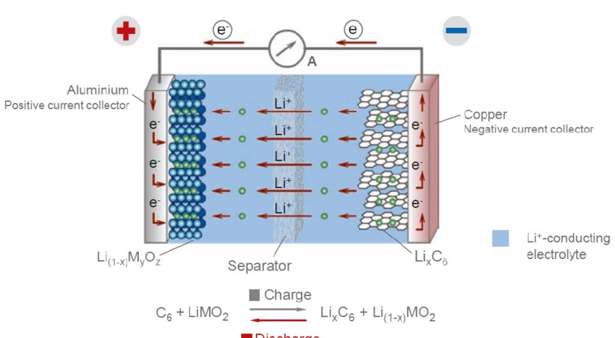
The Power Source

Slide 5
Electromotive Force (EMF)
Physical meaning: a quantity that measures how strongly a source converts other forms of energy into electric potential energy.
Definition: the ratio of the work done by non-electrostatic forces to the charge moved
𝐸=𝑊/𝑞
Unit: volt (V)

Slide 6
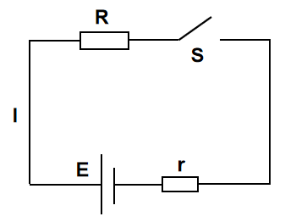
EMF and Voltage

Slide 7
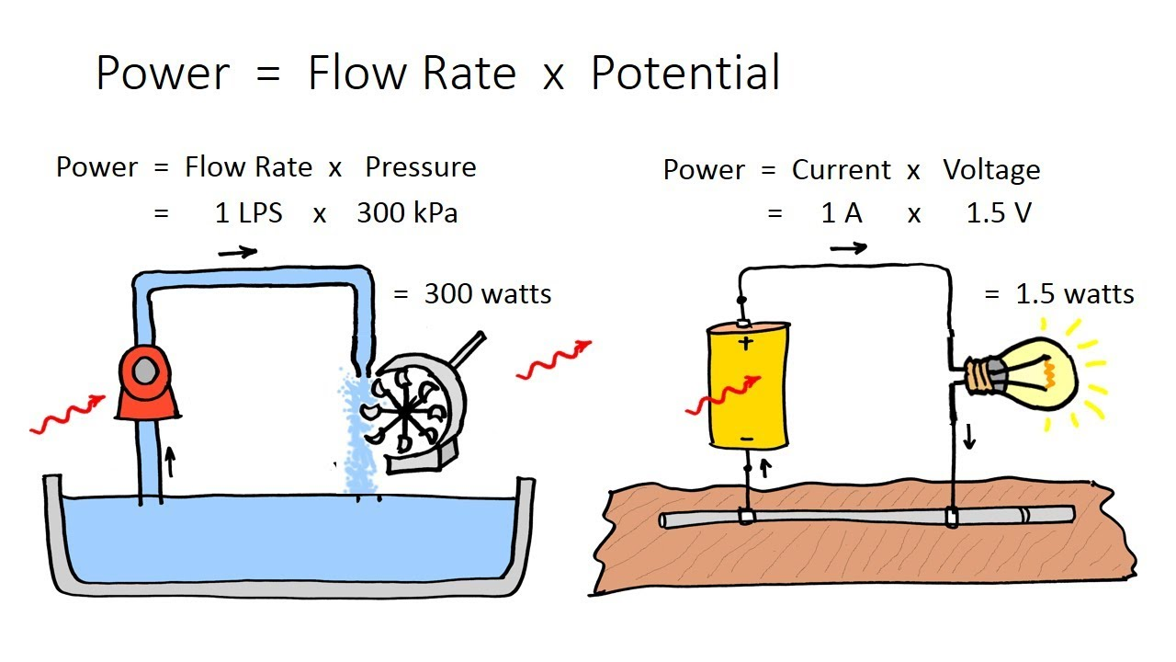
EMF and Voltage

Slide 8
Example 1 (Understanding EMF): Which statement is correct? ( )
A. The EMF of a source is proportional to the work done by non-electrostatic forces inside it, and inversely proportional to the charge that passes through
B. EMF has the same unit as voltage, so EMF is just the voltage between the two terminals of a source
C. The more work the non-electrostatic forces do, the greater the EMF
D. The EMF is determined by the nature of the non-electrostatic forces inside the source √
Solution: E＝𝑊/𝑞 is the defining equation of EMF; it does not mean E is proportional to W or inversely proportional to q. The EMF is determined by the nature of the non-electrostatic forces inside the source and does not depend on how much work they do, so A and C are wrong and D is correct. Although EMF has the same unit as voltage, EMF corresponds to the work done by non-electrostatic forces, while voltage corresponds to the work done by electrostatic forces, so B is wrong.

Slide 9
Example 2: A lead–acid battery has an EMF of 2 V; a dry cell, 1.5 V. Which of the following is correct? ( )
A. The voltage between the terminals of the lead–acid battery is 2 V
B. The dry cell can convert 1.5 J of chemical energy into electrical energy in 1 s
C. The EMF of the lead–acid battery changes when it is connected to different circuits
D. For the same charge passing through the circuit, the non-electrostatic forces do more work in the lead–acid battery than in the dry cell √

Slide 10
Write down the relationship between voltage, current and resistance in the circuit

Slide 11
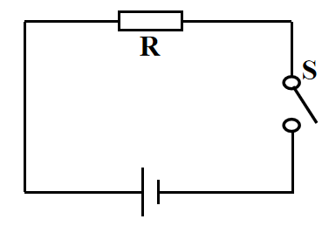
How does the electric potential change?

Slide 12
Inside the Source
+
-

Slide 13
Non-electrostatic Force
+
F_{e}
F_{ne}
-

Slide 14


Slide 15
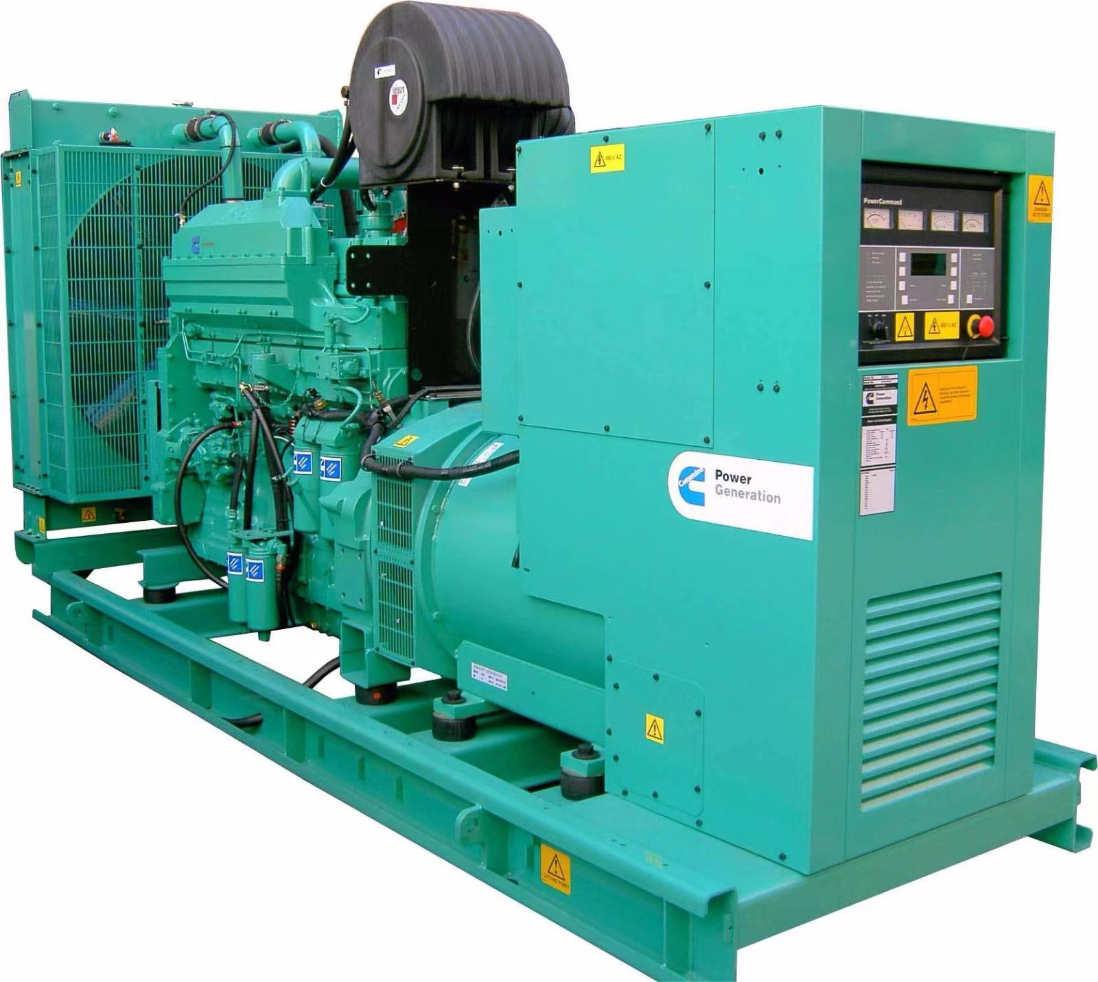

Energy Conversion
In a chemical battery, the non-electrostatic force is chemical in nature; it converts chemical energy into electric potential energy
In a generator, the non-electrostatic force is electromagnetic; it converts mechanical energy into electric potential energy

Slide 16
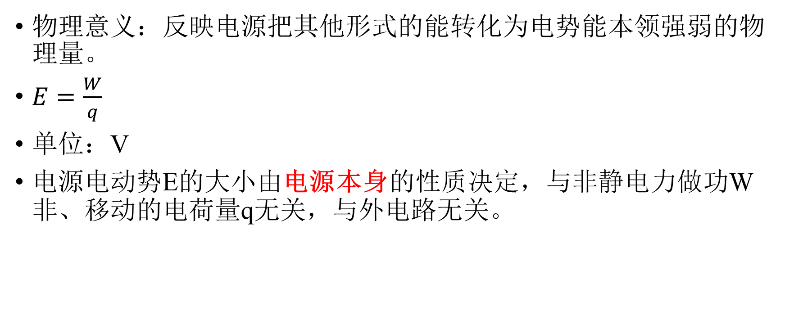
Electromotive Force (EMF)
Physical meaning: a quantity that measures how strongly a source converts other forms of energy into electric potential energy.
𝐸=𝑊/𝑞
Unit: V
The EMF E of a source is determined by the nature of the source itself; it does not depend on the work W_{non} done by non-electrostatic forces, the charge q moved, or the external circuit.

Slide 17
Which of the following statements about EMF is correct? ( )
A. EMF is just voltage, and its unit is V
B. A source with a larger EMF must do more work
C. A source with a larger EMF must do work faster
D. The EMF equals the energy the source supplies for each unit of charge passing through the circuit

Slide 18
A lead–acid battery has an EMF of 2 V; a dry cell has an EMF of 1.5 V. The two batteries are connected to separate circuits, carrying currents of 0.1 A and 0.2 A respectively. Both circuits run for 20 s. How much chemical energy does each source consume? Which battery is better at converting chemical energy into electrical energy?

Slide 19
The EMF of a source reflects its ability to convert other forms of energy into electrical energy. Therefore ( )
A. EMF is a kind of non-electrostatic force
B. A larger EMF means the source stores more electrical energy
C. The EMF reflects how much work the non-electrostatic forces can do
D. EMF is the voltage across the source in a closed circuit

Slide 20
Take a Closer Look at the Source

Slide 21
A source with internal resistance can be treated as an ideal source with no resistance, in series with a resistance r
E
r
E
r

Slide 22
Try to write the relationship between these quantities

Slide 23
Terminal Voltage

Slide 24
In the circuit shown, the resistance R = 2.0 Ω, the EMF of the source is 3.0 V, and the internal resistance r = 1.0 Ω. After switch S is closed, the terminal voltage is

Slide 25
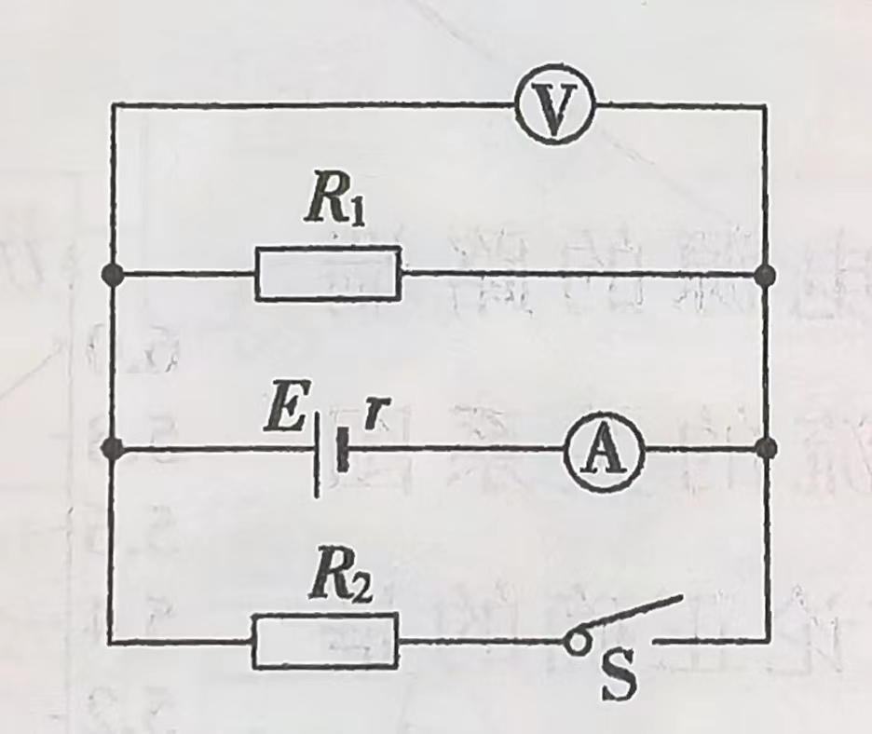
In the circuit shown, when S is closed the voltmeter and ammeter (both ideal) read 1.6 V and 0.4 A. When S is opened, their readings change by 0.1 V and 0.1 A respectively. Find the EMF and internal resistance of the source.

Slide 26
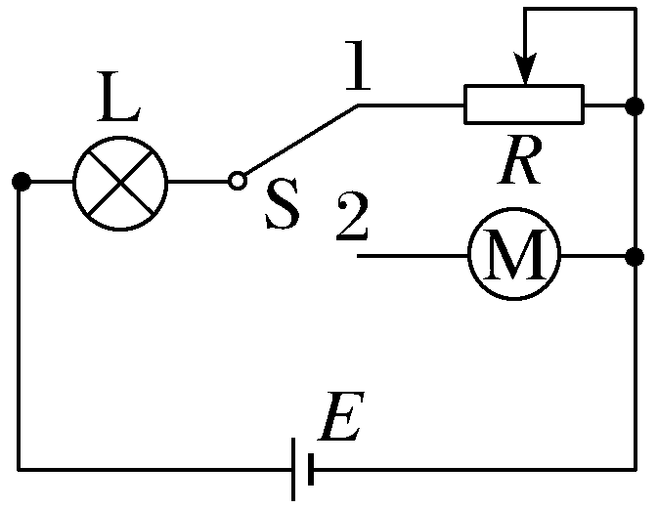
Example 4 (Ohm's law with a motor): As shown, the source EMF is E＝6 V. Bulb L is rated “3 V, 0.9 W”. With switch S at position 1 and the rheostat set to R＝8 Ω, bulb L operates normally. With S at position 2, both bulb L and motor M work normally. The motor's coil resistance is R₀＝2 Ω. Find:
(1) the internal resistance of the source;
Answer: 2 Ω

Slide 27
Solution: normal bulb resistance R_{L}＝𝑈_{rated}²/𝑃_{rated}＝10 Ω
The current through the bulb is I＝𝑃_{rated}/𝑈_{rated}＝0.3 A
With switch S at position 1: E＝I(R_{L}＋r＋R)
which gives the internal resistance r＝2 Ω.

Slide 28
(2) the input power, output power and efficiency of the motor.
Answers: 0.72 W 0.54 W 75％
Solution: with S at position 2 the bulb still works normally, so the current equals that with S at 1. Motor operating voltage U_{M}＝E－I(R_{L}＋r)＝2.4 V
Input power of the motor: P_{in}＝U_{M}I＝0.72 W
Heating power of the motor: P_{heat}＝I²R₀＝0.18 W
Output power of the motor: P_{out}＝P_{in}－P_{heat}＝0.54 W
Efficiency of the motor: η＝𝑃_{out}/𝑃_{in}×100％＝0.54/0.72×100％＝75％.

Slide 29
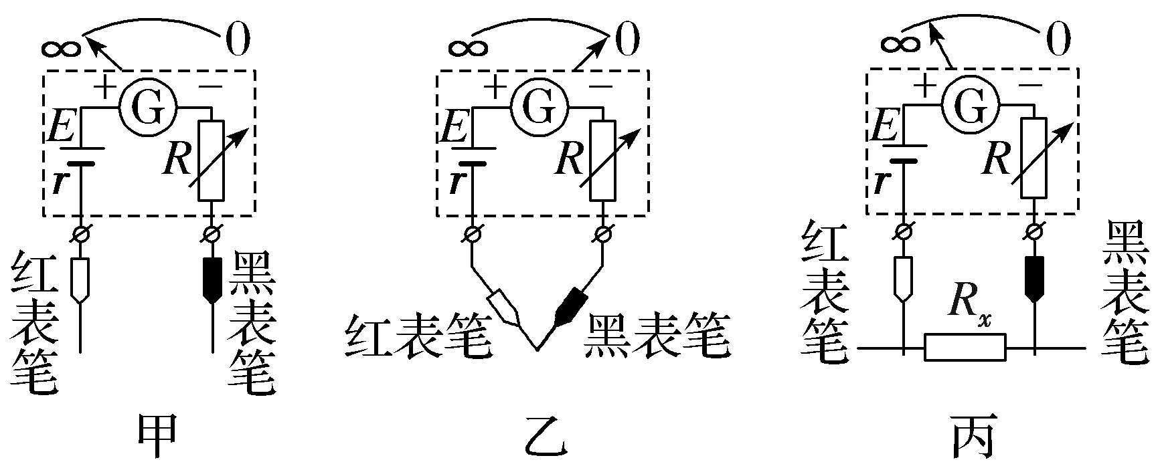
How an Ohmmeter Works
1. Principle of the ohmmeter
(1) Circuit structure: as shown.
(2) Measuring principle: Ohm's law for closed circuits.

Slide 30
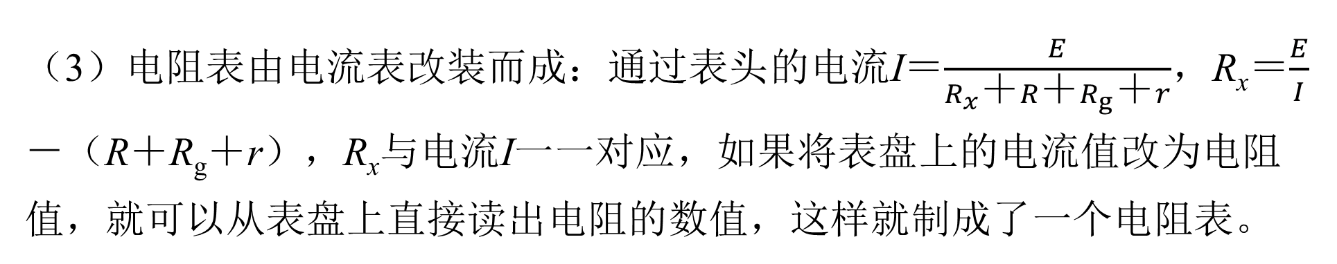
(3) An ohmmeter is converted from a galvanometer: the current through the meter is I＝𝐸/(𝑅_{𝑥}＋𝑅＋𝑅_{g}＋𝑟); R_{x}＝𝐸/𝐼 －(R＋R_{g}＋r). Each R_{x} matches one current I, so relabelling the current marks with resistance values makes an ohmmeter.
(4) Internal resistance of the ohmmeter: R_{int}＝R＋R_{g}＋r.
(5) Zero adjustment: R is a rheostat, also called the zero-adjusting resistor. By adjusting it, the pointer can be set to the “0 Ω” mark.

Slide 31
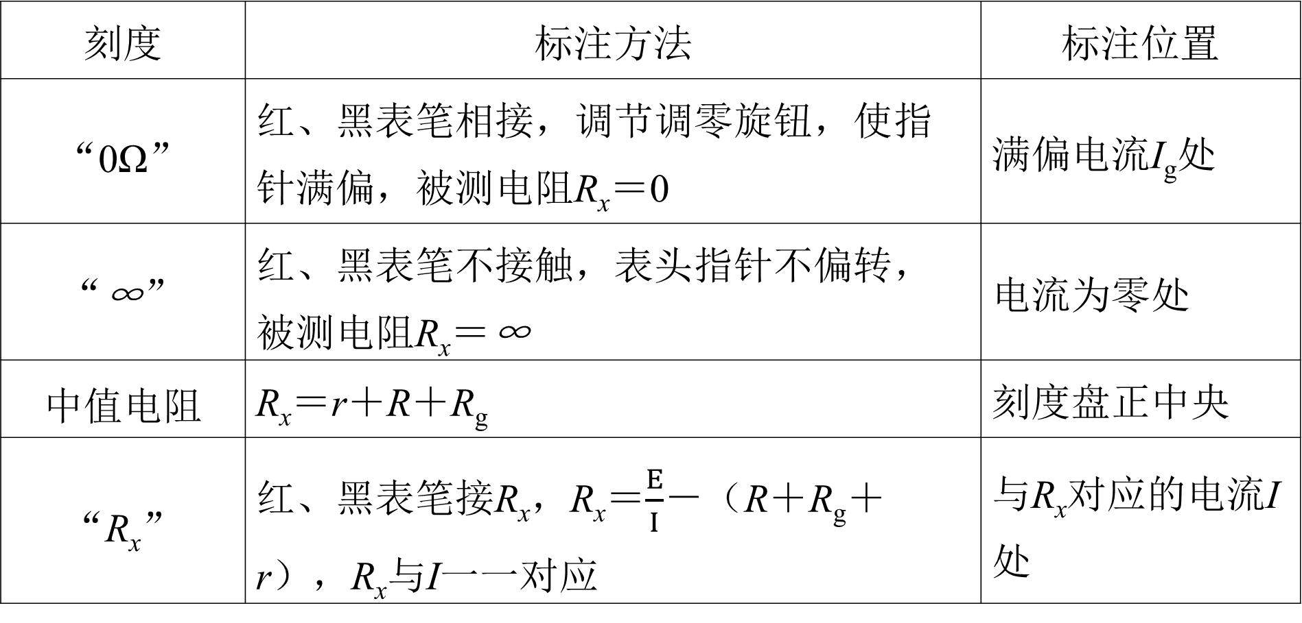
2. Features of the scale markings
Mark | How it is set | Position on dial
“0Ω” | Probes together; adjust zero knob to full scale; R_{x}＝0 | At the full-scale current I_{g}
“∞” | Probes apart; no deflection; R_{x}＝∞ | At zero current
Mid-scale resistance | R_{x}＝r＋R＋R_{g} | At dial centre
“R_{x}” | Across R_{x}; R_{x}＝E/I－(R＋R_{g}＋r) | At its current I

Slide 32
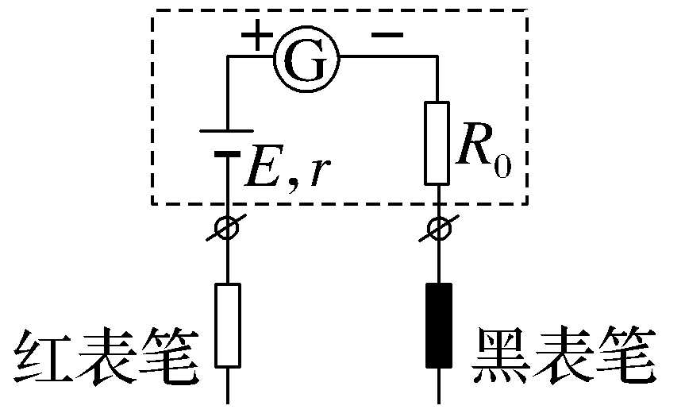
Worked Example: the working principle of an ohmmeter.
(1) Full-scale current I_{g}＝500 μA, dry-cell EMF 1.5 V. Fill in the resistance value for each current mark:
Current mark | 0 | 200 μA | 300 μA | 500 μA
Resistance mark | ∞ | ⁠ | ⁠ | ⁠
4.5×10³ Ω
2×10³ Ω
0

Slide 33
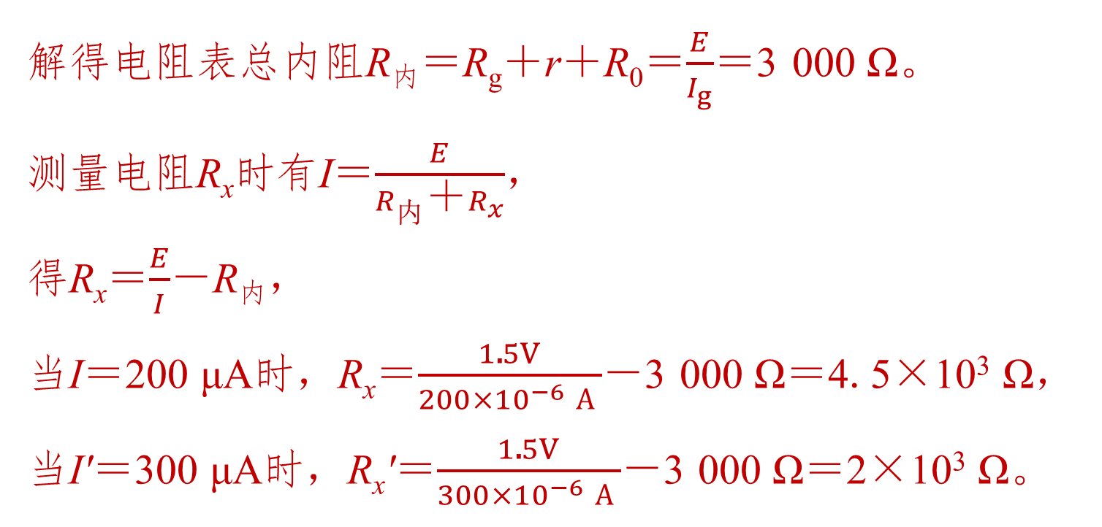
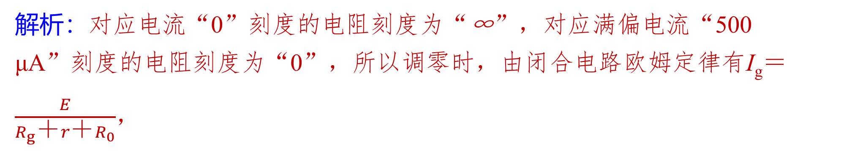
Solution: the mark for current “0” is “∞”; for full-scale “500 μA” it is “0”. When zeroing, I_{g}＝ 𝐸/(𝑅_{g}＋𝑟＋𝑅₀),
which gives the total internal resistance R_{int}＝R_{g}＋r＋R₀＝𝐸/𝐼_{g}＝3 000 Ω.
When measuring a resistance R_{x}: I＝𝐸/(𝑅_{int}＋𝑅_{𝑥}),
so R_{x}＝𝐸/𝐼－R_{int}.
When I＝200 μA: R_{x}＝1.5V/(200×10⁻⁶ A)－3 000 Ω＝4.5×10³ Ω;
when I'＝300 μA: R_{x}'＝1.5V/(300×10⁻⁶ A)－3 000 Ω＝2×10³ Ω.

Slide 34
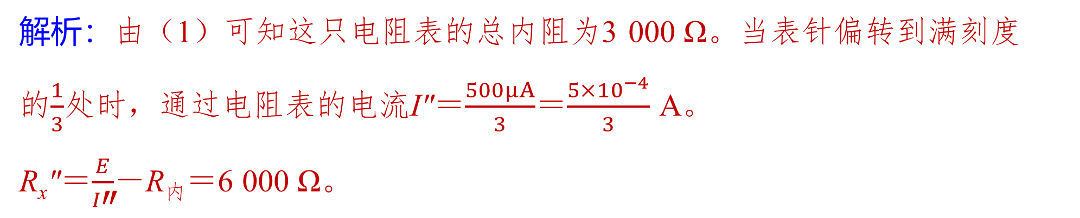
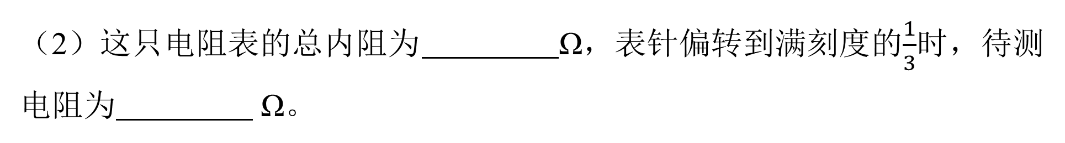
(2) The total internal resistance of this ohmmeter is 3 000 Ω. When the pointer deflects to 1/3 of full scale, the resistance being measured is 6 000 Ω.
Solution: from (1), the total internal resistance of the ohmmeter is 3 000 Ω. When the pointer deflects to 1/3 of full scale, the current through the ohmmeter is I″＝500μA/3＝(5×10⁻⁴)/3 A.
R_{x}″＝𝐸/𝐼″－R_{int}＝6 000 Ω.

